Slide 1
“Advanced Cancer Detection from Microscopic Tissue Images with Grad-CAM Implementation”
REVIEW - 2

Slide 2
Presented By
21MIS1070 - MINNA FATHIMA
Guided By
DR. PREM SANKAR N

Slide 3
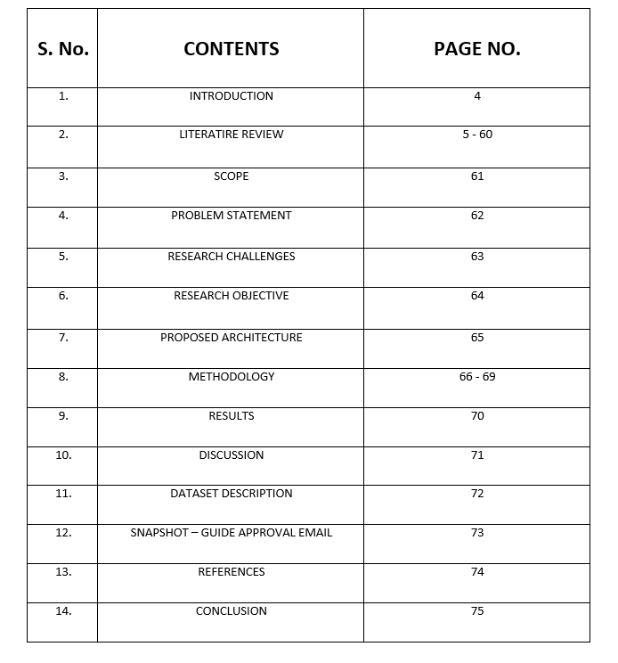
Outline

Slide 4
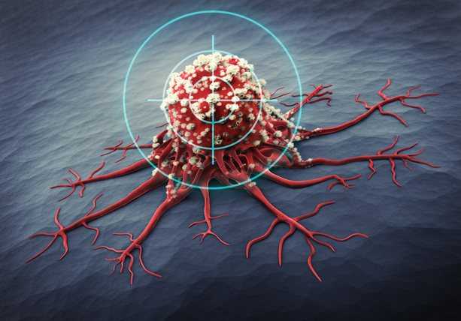

Introduction
Cancer remains one of the most pressing health challenges worldwide, with histopathological examination being the gold standard for diagnosis. Microscopic tissue image analysis, while effective, is labor-intensive and subject to inter-observer variability among pathologists. With the rapid progress of
artificial intelligence, deep learning techniques have shown great promise in
automating cancer detection by learning intricate patterns in medical images.
Convolutional Neural Networks (CNNs) excel at capturing fine-grained local
features such as cell shapes and textures, while Vision Transformers (ViTs) are
adept at modeling long-range dependencies and global contextual relationships. By combining these strengths into a hybrid model, it becomes possible to achieve higher accuracy and robustness in cancer detection. This research aims to design such a hybrid architecture to process microscopic tissue images efficiently, improving diagnostic precision while reducing the workload on medical professionals.

Slide 5
Literature Review

Slide 6
S. No. | Author(s), Year | Method / Approach | Key Contribution | Gap Identified
1 | Baljinder Kaur et al., 2022 | Recent advancements in optical biosensors for cancer detection (THz, ECL, SERS, paper-based) | Highlighted novel biosensing platforms for early cancer detection; low-cost and high-sensitivity techniques demonstrated | Lack of universal biomarkers; high fabrication costs; poor stability and scalability
2 | Rebecca Fitzgerald et al., 2022 | The future of early cancer detection | Stressed proactive screening, individualized risk assessment, and AI-enabled diagnostics | Challenge in distinguishing benign vs malignant lesions; accessibility and cost barriers
3 | Yongjie Xu et al., 2025 | Liquid biopsy-based multi cancer early detection (AI for MCED) | Multi-biomarker liquid biopsy with AI integration; ongoing large-scale trials (Galleri, PATHFINDER 2) | Low early-stage sensitivity; cost-effectiveness concerns; overdiagnosis risks; integration into healthcare workflows
4 | Rekeraui et al., 2025 | Review on electrochemical biosensors in cancer detection | Discussed immunosensors, aptasensors, enzyme-based & nanomaterial-enhanced detection for point-of-care cancer diagnostics | Limited reproducibility, scalability, and clinical validation; regulatory barriers
5 | Guohul Cai et al., 2024 | Survey of AI in lung cancer detection via CT | Compared ML vs DL for pulmonary nodule analysis; DL showed superior accuracy in CAD workflows | Data scarcity; interpretability issues; poor clinical adoption; lack of standard metrics

Slide 7
S. No. | Author(s), Year | Method / Approach | Key Contribution | Gap Identified
6 | Muge Yucel et al., 2025 | Digital sensing in cancer care (biosensors, lab-on-chip, wearables, AI) | Showed integration of AI + nanotech for personalized, remote, and real-time cancer monitoring | Data privacy/security; lack of universal standards; scalability and clinical integration challenges
7 | Sultana & Ghosh, 2025 | Review on Exosome: The hidden messengers in cancer detection and immunotherapy | Highlighted exosomes as biomarkers for liquid biopsy and as platforms in cancer immunotherapy | Poor understanding of biogenesis; lack of standardization in isolation; scalability issues; risk of off-target effects
8 | Sado et al., 2024 | Variational Auto Encoder-based anomaly detection (DL) using transcriptomic data | Achieved high precision & recall in pan-cancer detection using TCGA/GTEx; unsupervised adaptable model | Tested on limited cancers; black-box interpretability; scalability & real-world validation gaps
9 | Haue et al., 2024 | AI + EHR-based multimodal data mining | AI-enhanced risk prediction using structured/unstructured EHR data; potential to detect cancer earlier | Infrastructure limits; data drift; lack of diverse datasets; survival benefit not fully proven; inequity across regions
10 | Feng Zhou et al., 2024 | Observational study on COVID-19 & endoscopic cancer detection | Showed drastic drop in endoscopic activity; backlog led to missed gastric cancer diagnoses; recovery uneven across cancers | Lack of staging data; limited generalizability; no evaluation of interventions; single-region focus

Slide 8
S. No. | Author(s), Year | Method / Approach | Key Contribution | Gap Identified
11 | Aksoy et al., 2024 | Advanced biosensor technologies (electrochemical, optical, mass-based + nanomaterials, AI/ML) for early stage oral cancer diagnosis | Highlighted biosensors for early oral cancer detection; integration with AI for higher sensitivity, portability, and minimally invasive screening | Limited large-scale clinical validation; lack of biomarker standardization; cost & scalability issues; specificity challenges; weak integration into healthcare systems
12 | Javed et al., 2024 | EfficientNetB1 with transfer learning on LC25000 histopathology dataset for lung cancer detection | Achieved 99.8% accuracy in classifying lung cancer subtypes; superior precision/recall vs older models | Reliance on single dataset; no external validation; limited explainability; GPU dependency; robustness not tested on noisy data
13 | Mengdi Han et al., 2024 | Echo State Network (RNN) optimized with Enhanced Seasons Optimization Algorithm for timely skin cancer detection | Proposed AI model for skin cancer detection with 97.6% accuracy, outperforming existing benchmarks; efficient on limited data | Dataset diversity unclear; no external validation; lack of XAI; no detailed false positive/negative analysis; no clinical trial evidence
14 | Wan et al., 2024 | Nanomaterial-assisted electrochemical detection platforms for lung cancer diagnosis | Showed how nanomaterials (AuNPs, graphene, CNTs) improve sensitivity to fg/mL levels; portable lab-on-chip systems with multiplex detection | Few large-scale trials; lack of standardization; stability & biocompatibility issues; commercial translation challenges
15 | Gholami et al., 2021 | CNN (feature extraction) + SVM (classification) on tongue images | Non-invasive gastric cancer diagnosis using tongue color/lint features; DenseNet reached 91% accuracy | Small/limited dataset; generalizability issues; no explainability; no clinical validation; poor integration with healthcare

Slide 9
S. No. | Author(s), Year | Method / Approach | Key Contribution | Gap Identified
16 | Bulusu et al., 2025 | Review of AI in early cancer detection (MRI, CT, USG, histopathology) | Outlined AI workflow (acquisition → preprocessing → classification → validation); highlighted CNNs, transfer learning, hybrid models | Lack of large annotated datasets; poor generalization; no standardization; ethical/privacy concerns; interpretability challenges
17 | William Hwang .,et al., 2025 | DL applications in clinical cancer detection (imaging, genomics, multimodal) | Discussed CNNs, federated learning, explainable AI, synthetic data for reliable cancer detection | Limited annotated datasets; low interpretability; regulatory/ethical hurdles; integration into clinical workflows remains weak
18 | Tiwari et al., 2025 | AI across cancer care continuum (diagnosis, treatment, management) | Showed AI applications from early detection to therapy planning and patient monitoring; discussed federated learning, quantum AI | Data privacy/security issues; lack of transparency; poor standardization; regulatory/legal hurdles; limited diverse datasets
19 | Jiang et al., 2023 | DL in medical image-based diagnosis (histopathology, radiology, WSI) | Highlighted CNN-based models for classification/segmentation; patch-based methods for WSI; transfer learning & augmentation | Overfitting common; limited external validation; biased datasets; lack of interpretability
20 | Ibrahim et al., 2022 | Survey of CNN-based cancer categorization methods | Traced CNN evolution (AlexNet→VGG→modern) for multiple cancers; discussed preprocessing, augmentation, benchmark datasets | Data scarcity; overfitting; heterogeneity across imaging modalities; lack of interpretability

Slide 10
S. No. | Author(s), Year | Method / Approach | Key Contribution | Gap Identified
21 | Olthof et al., 2024 | Nationwide Dutch cohort study comparing MRI, CT, and [18F]FDG-PET-CT for cervical cancer lymph node staging | PET-CT showed highest sensitivity (80%) & diagnostic performance; MRI remains strong first-line tool; combination improves reliability in high-risk cases | PET-CT lower specificity (risk of false positives); underperformance in common iliac nodes; limited access/cost; retrospective design; need for prospective validation
22 | Kumar et al., 2024 | Review of AI in cancer detection (radiology, pathology, genomics, CDSS) | AI enhances lesion detection, pathology segmentation, genomics-based risk stratification, and clinical decision support | Data bias; lack of standard datasets; poor interpretability (black-box models); regulatory/ethical/privacy hurdles; deployment challenges
23 | Yucel et al., 2025 | Review of digital sensing technologies (wearables, liquid biopsy, biomarkers) integrated with AI | Enabled continuous/non-invasive monitoring; early detection before symptoms; potential for population-scale screening | Sensor reliability issues; data privacy & security concerns; regulatory hurdles; false positives/negatives in low-signal stages
24 | Imai et al., 2025 | Multi-Cancer Early Detection (MCED) assays using liquid biopsy (cfDNA, methylation, fragmentomics) | MCED achieves 50–95% sensitivity, 89–99% specificity; fills screening gaps for cancers without current programs | Variable sensitivity (esp. early-stage cancers); ethical/psychosocial impact of false positives; cost & integration into healthcare; need for validation across diverse populations
25 | KalaiSelvi et al., 2025 | IoT-driven cancer prediction combining sensors + AI to detect protein misfolding/structural variation | Continuous monitoring of molecular/proteomic changes; potential for proactive detection before symptoms; IoT as bridge between biology & computational AI | IoT sensor reliability/calibration issues; biological noise & variability; workflow integration challenges; security/privacy concerns in IoT data

Slide 11
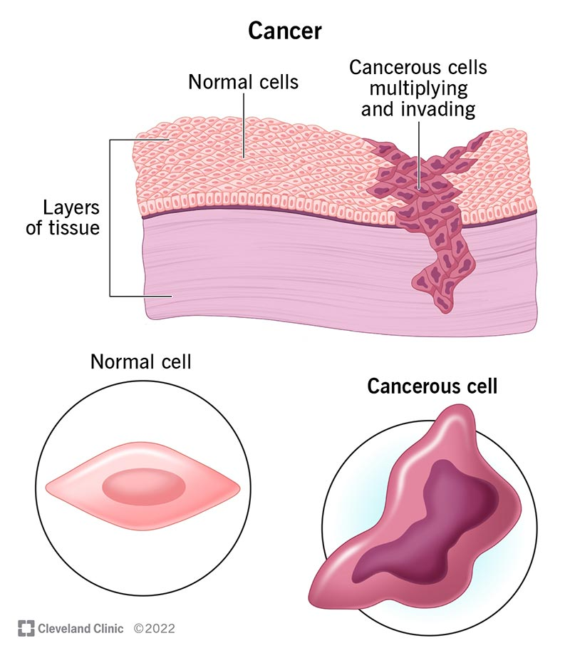
Literature Review (in detail)
1. Recent advancements in optical biosensors for cancer detection - 2022
Baljinder Kaur, Santosh Kumar, Brajesh Kumar Kaushik
This review paper presents recent advancements in optical biosensing techniques for early cancer detection, focusing on terahertz (THz)-based biosensors, electrochemiluminescence (ECL) biosensors, surface-enhanced Raman scattering (SERS) sensors, and paper-based optical sensors. THz biosensors exploit deep tissue penetration and large-area measurement without requiring skilled professionals, while ECL biosensors achieve high sensitivity through chemiluminescent immunoassays. SERS-based detection uses plasmonic nanostructures, such as silver nanorod arrays, to identify lung cancer biomarkers at attomolar levels, and paper-based sensors provide low-cost, point-of-care breast cancer detection via nanocomposites on nitrocellulose paper. The paper identifies challenges such as the absence of universal biomarkers, high nanostructure fabrication costs, and low material stability, and emphasizes future research directions including novel single-gene/protein biomarkers, multifunctional biosensor platforms, and improved nanostructure functionalization for commercialization.

Slide 12
Themes
Advancements in optical biosensing for early cancer detection using diverse platforms (THz, ECL, SERS, paper-based).
THz biosensors enabling deep tissue penetration and large-area imaging without need for highly skilled operators.
ECL biosensors providing high sensitivity via chemiluminescent immunoassays for biomarker detection.
SERS-based sensing utilizing plasmonic nanostructures (e.g., silver nanorod arrays) for ultra-low concentration biomarker detection (attomolar levels).
Paper-based sensors offering low-cost, point-of-care solutions, especially for breast cancer, using nanocomposite coatings.
Gaps
Lack of universal and standardized cancer biomarkers for broad-spectrum detection.
High fabrication costs for advanced nanostructures, limiting affordability.
Low stability and durability of sensing materials under real-world operating conditions.
Limited scalability and commercialization potential due to manufacturing and reproducibility challenges.
Need for improved multifunctional and integrated biosensor platforms for clinical adoption

Slide 13
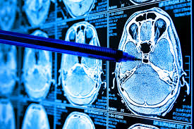
2. The future of early cancer detection - 2022
Rebecca C. Fitzgerald, Antonis C. Antoniou, Ljiljana Fruk & Nitzan Rosenfeld
This Nature Medicine review emphasizes the importance of proactive early cancer detection to improve treatment effectiveness, minimize side effects, and enhance long-term survival. It highlights the challenge of distinguishing harmless abnormalities from lesions that could progress to life-threatening cancer, particularly as detection methods grow more sensitive. The authors stress the need for individualized risk assessment, clear staging of cancer development, diverse and optimally performing diagnostic tools, and careful evaluation of societal and personal implications. Future advancements in sensors, contrast agents, molecular diagnostics, and artificial intelligence are expected to enable real-time detection of cancer-specific signals. The review also underlines the importance of cost-effective, risk-based screening and prevention strategies that are widely accessible to reduce the overall burden of cancer.

Slide 14
Themes
Proactive early cancer detection to improve outcomes and survival rates.
Individualized risk assessment for tailored screening and treatment strategies.
Development of advanced diagnostic tools including sensors, contrast agents, and molecular diagnostics.
AI integration for real-time cancer-specific signal detection and decision support.
Emphasis on cost-effective, widely accessible, risk-based screening to reduce cancer burden.
Gaps
Difficulty differentiating harmless abnormalities from potentially life-threatening lesions.
Limited accessibility to risk-based screening in underserved populations.
Need for optimization of diagnostic tool performance across cancer types and stages.
Integration challenges of new technologies into standard clinical workflows.
Balancing sensitivity and specificity to avoid overdiagnosis and unnecessary treatment.

Slide 15
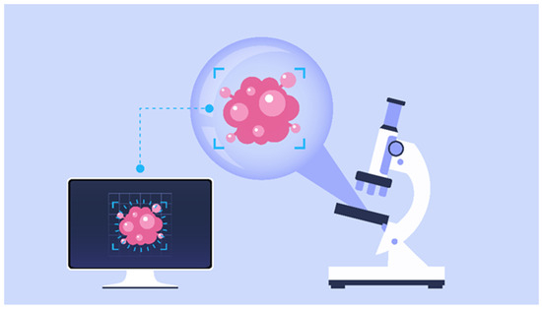
3. Liquid biopsy-based multi-cancer early detection: an exploration road from evidence to implementation -2025
Yongjie Xu, Sibo Zhu, Changfa Xia, Hui Yu, Si Shi, Kezhong Chen, Yue He, Chuxia Deng, Haoxuan Jin, Jing Liu, Rebecca Fitzgerald, Partha Basu, Wanqing Chen
The paper reviews recent advances in multi-cancer early detection (MCED) using liquid biopsy
techniques combined with AI to analyze biomarkers such as cfDNA methylation, fragmentation
patterns, mutations, circulating proteins, metabolites, and cfRNA, enabling detection of multiple cancer types and prediction of the tissue of origin (TOO). Completed trials show high specificity (>97%) and variable sensitivity (27–88%), with some assays like PanSeer and MERCURY achieving over 75% sensitivity in stage I cancers, though early-stage detection remains a challenge for many. Large ongoing trials, including NHS-Galleri and PATHFINDER 2, are evaluating the real-world impact of MCED on cancer incidence, stage at diagnosis, and mortality across tens of thousands of participants. MCED offers the potential for earlier diagnosis, especially for cancers lacking current screening programs, and more targeted follow-up via TOO prediction, but further work is needed to improve early-stage sensitivity, ensure cost-effectiveness, and avoid overdiagnosis before widespread adoption.

Slide 16
Themes
Multi-cancer early detection (MCED) using minimally invasive liquid biopsies.
Biomarker diversity including cfDNA methylation, fragmentation patterns, mutations, proteins, metabolites, and cfRNA.
AI integration for biomarker analysis and enhanced diagnostic accuracy.
Tissue-of-origin (TOO) prediction to enable targeted follow-up and treatment.
Large-scale clinical trials (e.g., NHS-Galleri, PATHFINDER 2) assessing real-world impact on cancer incidence, staging, and mortality.
Gaps
Low sensitivity in detecting early-stage cancers for many current MCED assays.
Need for cost-effective solutions to enable large-scale screening adoption.
Risk of overdiagnosis leading to unnecessary interventions.
Limited clinical validation for some biomarker combinations in diverse populations.
Integration challenges into existing healthcare infrastructure and workflows.

Slide 17
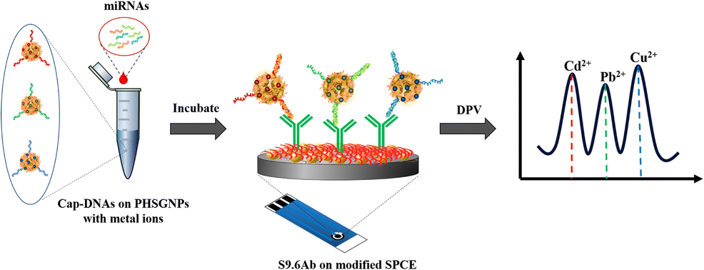
4. Advances in cancer detection: A review on
electrochemical biosensor technologies - 2025
Valentine Saasa , Rekerayi Chibagidi , Keletso Ipileng , Usisipho Feleni
This review paper discusses recent advances in electrochemical biosensor technologies for early
cancer detection, focusing on their ability to detect cancer biomarkers with high sensitivity, specificity,
and cost-effectiveness. Traditional diagnostic methods like imaging and biopsies are often invasive,
expensive, and limited in early-stage detection, especially in low-resource settings. Electrochemical biosensors offer a non-invasive, portable, and rapid alternative by converting biological interactions of cancer-related biomarkers—such as nucleic acids, proteins, metabolites, and exosomes—into measurable electrical signals. The paper evaluates different types of biosensors, including immunosensors, aptasensors, nano-biosensors, enzyme-based, and non-enzymatic sensors, with nanotechnology (e.g., nanoparticles, carbon nanotubes, graphene) enhancing performance. It highlights key cancer biomarkers such as PSA, PCA3, CA15-3, and CA125, their clinical importance, and examples of biosensor-based detection. While showing great promise for point-of-care diagnostics and integration into personalized medicine, challenges remain in improving specificity, reproducibility, and scalability for widespread clinical use.

Slide 18
Themes
Electrochemical biosensors as a rapid, cost-effective alternative to traditional cancer diagnostics.
Nanotechnology-enhanced detection using nanoparticles, CNTs, and graphene to boost sensitivity and performance.
Non-invasive diagnostics for early-stage cancer detection in low-resource and point-of-care settings.
Biomarker-driven testing targeting PSA, PCA3, CA15-3, CA125, and other clinically relevant markers.
Integration into personalized medicine for tailored cancer monitoring and treatment
Gaps
Limited specificity and reproducibility across diverse patient populations.
Scalability challenges for manufacturing and deployment in clinical settings.
Need for large-scale clinical validation in real-world conditions.
Standardization issues in biosensor fabrication and calibration.
Regulatory and commercialization hurdles slowing clinical adoption.

Slide 19

5. Medical artificial intelligence for early detection of lung cancer: A survey - 2024
Guohui Cai, Ying Cai, Zeyu Zhang, Yuanzhouhan Cao , Lin Wu, Daji Ergu, Zhibin Liao, Yang Zhao
This survey reviews AI-driven approaches for early lung cancer detection, with a focus on pulmonary
nodule analysis using computed tomography (CT) images. It compares 131 studies, covering both
traditional machine learning (ML) methods like SVM and k-NN, and deep learning (DL) techniques
such as CNNs, RNNs, and GANs. Deep learning outperforms traditional ML by automatically learning complex features, improving detection, segmentation, and classification accuracy, especially for high-risk nodule types (subsolid and ground-glass). The paper outlines key datasets (e.g., LIDC-IDRI, LUNA16), CAD system workflows, and breakthroughs like multi-task CNNs and ensemble models. While DL has enhanced early diagnosis and reduced radiologist workload, challenges remain in data scarcity, model interpretability, and clinical adoption. The authors provide guidance on designing efficient, interpretable workflows to optimize computational complexity and improve real-world applicability in lung cancer screening.

Slide 20
Themes
AI-powered CAD systems for automated CT-based lung cancer screening.
Shift from traditional ML to DL (CNNs, RNNs, GANs) enabling complex feature learning.
Pulmonary nodule analysis covering detection, segmentation, and classification, with focus on high-risk nodule types.
Ensemble and multi-task models improving robustness and accuracy.
Workflow optimization for accuracy, interpretability, and reduced radiologist workload.
Gaps
Data scarcity of large, high-quality annotated CT datasets.
Model interpretability limitations, hindering clinical trust.
Challenges in clinical adoption due to integration and validation issues.
Lack of standardized evaluation metrics across studies.
Insufficient exploration of ML vs DL performance differences under a unified framework

Slide 21
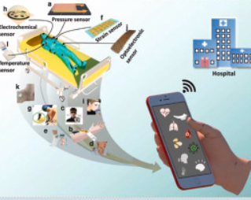
6. Digital sensing technologies in cancer care: A new era in early detection and personalized diagnosis - 2025
Muge Yucel, Ahmet Onder, Tolunay Kurt, Berfin Keles, Merve Beyaz, Yaren Karadag, İrem Yaşyerli A. Irem Celik, Fatih Sema, Senem Tetik, Sanem Dinçkal, Soner Karabacak, Palaniappan Alagappan, Bo Liedberg, Umit Hakan Yildiz
This open-access review highlights how digital sensing technologies—such as biosensors, lab-on-a-chip
devices, and wearable sensors—are revolutionizing cancer care by enabling early, non-invasive, and highly sensitive detection, along with personalized diagnosis and treatment planning. Integrating nanotechnology with AI and machine learning, these platforms allow real-time monitoring of cancer biomarkers through tools like liquid biopsies and point-of-care diagnostics, improving accessibility and clinical decision-making, even in remote settings. By continuously collecting and analyzing patient-specific data, they enhance tumor profiling, optimize therapy customization, and support proactive cancer management, ultimately improving survival rates and quality of life. However, challenges remain in data privacy, standardization, regulatory approval, and clinical integration.

Slide 22
Themes
AI-integrated biosensing platforms for enhanced cancer detection and diagnosis.
Wearable and point-of-care (POC) devices enabling real-time, non-invasive monitoring.
Liquid biopsy integration for biomarker-based early detection.
Nanotechnology-enhanced diagnostics for higher sensitivity and specificity.
Cloud/IoT-enabled remote monitoring supporting continuous data collection and analysis.
Personalized treatment planning through patient-specific, real-time data insights.
Gaps
Lack of universal standards for device performance and interoperability.
Data privacy and security concerns in cloud-connected systems.
Poor clinical integration due to workflow and infrastructure barriers.
Scalability challenges in low-resource and rural settings.
Need for large-scale clinical validation to ensure reliability and adoption.
Low patient and clinician adoption due to trust and usability issues.
Ethical concerns around continuous health monitoring and data ownership.

Slide 23
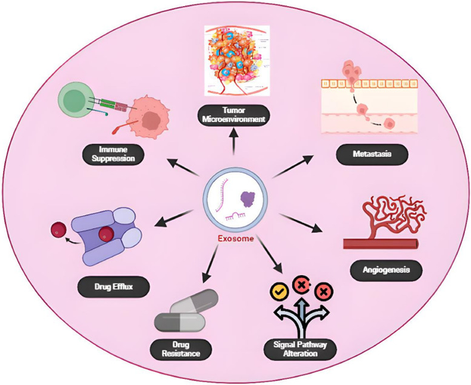
7. Exosome: The hidden messengers in cancer detection and immunotherapy - 2025
Fahmida Sultana MSc, Ajit Ghosh PhD
This review explores the multifaceted role of exosomes in cancer biology, highlighting their dual nature as both promoters of tumor progression and promising tools for diagnosis and therapy. Tumor-derived exosomes (TDEs) carry oncogenic proteins, lipids, and nucleic acids that reprogram the tumor microenvironment, enabling immune suppression, angiogenesis, metastasis, and drug resistance. Their abundance in body fluids makes them valuable candidates for liquid biopsies, offering non-invasive biomarkers for early detection, prognosis, and real-time disease monitoring. Beyond diagnostics, exosomes are emerging as powerful platforms in cancer immunotherapy, including vaccine development and targeted immune modulation. Despite these advances, challenges remain in understanding their biogenesis, standardizing isolation techniques, ensuring clinical scalability, and minimizing off-target effects, underscoring the need for further research to fully realize their potential in precision oncology.

Slide 24
Themes
Exosomes as mediators of cancer progression – facilitating immune suppression, angiogenesis, metastasis, and
drug resistance.
Tumor-derived exosomes (TDEs) – carrying oncogenic proteins, RNAs, and signaling molecules that remodel the
tumor microenvironment (TME).
Exosomes in liquid biopsy – serving as non-invasive biomarkers for cancer detection, prognosis, and real-time monitoring.
Exosome-based cancer immunotherapy – potential in vaccines, immune modulation, and targeted delivery of therapeutic agents.
Dual role of exosomes – both promoting tumor survival and serving as diagnostic/therapeutic tools in precision medicine.
Gaps
Incomplete understanding of exosome biogenesis – especially under TME conditions like hypoxia and acidity.
Challenges in standardizing isolation and quantification methods for clinical applications.
Limited clinical translation due to scalability, reproducibility, and regulatory approval barriers.
Risk of off-target effects in therapeutic applications of exosomes.
Need for large-scale validation of exosome-based biomarkers for early cancer detection and monitoring.

Slide 25
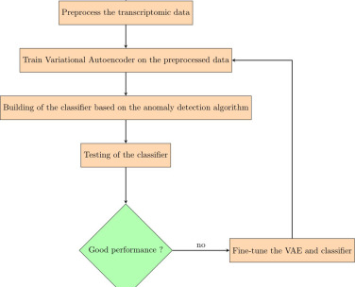
8. Early multi-cancer detection through deep learning: An anomaly detection approach using Variational Autoencoder - 2024
IIT Sado, Louis Fippo Fitime , Geraud Fokou Pelap, Claude Tinku, Gaelle Mireille Meudje, Thomas Bouetou
This paper proposes a deep learning–based anomaly detection approach using a Variational Autoencoder
(VAE) to enable early, multi-cancer detection from transcriptomic data without being limited to specific
cancer types. Leveraging datasets from TCGA and GTEx, the model learns to identify cancer as deviations from normal gene expression profiles, overcoming challenges such as high dimensionality, unlabeled data, and poor adaptability of existing methods to new cancers. The VAE architecture, trained with an Adam optimizer and a two-component loss function, achieved high performance with precision of 1.0 and recall between 0.83–0.89 across six cancer types. This method offers a scalable, unsupervised, and adaptable solution for pan-cancer early detection, potentially identifying malignancies before they become visible through conventional imaging, while addressing key limitations of current transcriptomic and imaging-based screening approaches.

Slide 26
Themes
Early multi-cancer detection using transcriptomic data rather than single-cancer focus.
Anomaly detection via Variational Autoencoder (VAE) for unsupervised learning.
Pan-cancer adaptability — model can generalize to multiple and new cancer types.
Overcoming high-dimensional data challenges in gene expression analysis.
Improved precision and recall compared to traditional imaging-based early detection.
Gaps
Limited cancer type coverage — tested on only six cancers; broader validation needed.
Transcriptomic data dependency — performance may vary with data quality and preprocessing.
Interpretability issues — deep learning “black box” limits biological insight.
Scalability & real-world integration challenges for clinical deployment.
Need for larger, more diverse datasets to ensure generalization across populations.

Slide 27
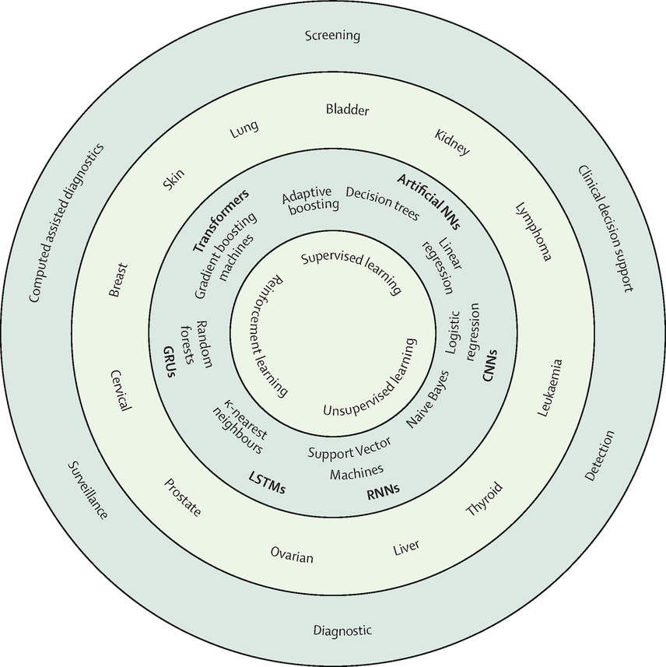
9. Artificial intelligence-aided data mining of medical
records for cancer detection and screening - 2024
Amalie Dahl Haue, Jessica Xin Hjaltelin, Peter Christoffer Holm, Davide Placido, S⊘ren Brunak
This review explores how artificial intelligence (AI) applied to multimodal, population-wide electronic
health records (EHRs) can transform cancer screening and early detection by leveraging deep phenotyping
from thousands of structured and unstructured data features. AI models can integrate longitudinal clinical, molecular, imaging, and socioeconomic data to detect malignancies earlier, even before histopathological confirmation, and improve risk stratification beyond traditional scoring systems. The paper discusses opportunities to overcome current screening limitations—such as lead-time bias and false positives—while addressing key challenges, including infrastructure for prospective testing, data drift, bias, and the need for large, diverse datasets. It also highlights barriers in translating high-performing retrospective models into real-time clinical practice, regulatory considerations, and the persistent disparities in AI-based screening access between high-income and low-/middle-income countries.

Slide 28
Themes
AI in cancer screening and early detection using multimodal, population-wide electronic health records (EHRs).
Deep phenotyping — extracting thousands of features to improve cancer risk prediction.
Integration of structured and unstructured data (tabular, imaging, time-series, free text).
Overcoming screening limitations like lead-time bias, low specificity, and false positives.
Bridging research and practice — from retrospective model development to real-world clinical implementation.
Ethical considerations — bias detection, equitable access, and global screening disparities.
Gaps
Infrastructure limitations for prospective testing and real-time clinical deployment.
Data bias & drift — changing healthcare data over time may degrade model accuracy.
Need for large, diverse datasets to reflect population heterogeneity.
Limited proof of survival benefit despite cost-effectiveness of AI screening.
Regulatory and integration challenges for operational adoption in healthcare systems.
Equity gap between high-income and low-/middle-income countries in AI-based screening access.

Slide 29
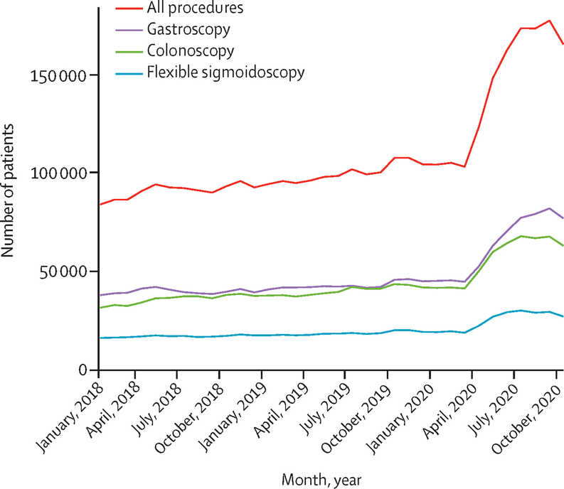
10. The recovery of endoscopic activity and cancer
detection after the COVID-19 pandemic - 2024
Feng Zhou, Jinhua Fu, Nanzhen Wu, Yang Liu, Yong Xie, Xiaojiang Zhou
The study examined the recovery of endoscopic activity and cancer detection after the COVID-19 peak
in a major Chinese endoscopy center. During February 2020, procedures dropped by over 90%, with cancer detection temporarily increasing due to prioritization of severe cases. Activity gradually returned to pre-pandemic levels by July, but cancer detection, especially for gastric cancer, lagged behind—colorectal cancer detection normalized by August, gastric cancer by September. Despite recovery, detection rates later fell below 2019 averages, and an estimated 6.69% of gastric cancer cases were missed. Older patients were slower to return due to COVID-19 risks, while younger patients’ share increased. The findings highlight that restoring service capacity alone is insufficient; targeted strategies, resource optimization, and public awareness are essential to address backlogs and prevent missed diagnoses during and after health crises.

Slide 30
Themes
Impact of COVID-19 on healthcare services: Severe reduction in endoscopic activity and cancer screening during pandemic peak.
Recovery patterns: Gradual restoration of procedural capacity, but delayed return of cancer detection, especially gastric cancer.
Cancer detection disparities: Colorectal cancer detection recovered faster than gastric cancer due to differences in screening methods and symptom onset.
Patient behavior changes: Older patients were more reluctant to return, while younger patients made up a larger share of post-peak procedures.
Backlog and missed diagnoses: Significant proportion of potential cancer cases, especially gastric cancer, remained undiagnosed despite service recovery.
Healthcare system resilience: Need for strategies to maintain essential cancer services during health crises.
Gaps
Long-term impact – Lack of follow-up data on outcomes for patients with delayed or missed cancer diagnoses.
Generalizability – Findings from a high-volume tertiary center may not apply to lower-resource settings.
Cancer staging data – Absence of tumor stage analysis limits understanding of disease progression due to delays.
Patient decision factors – Limited exploration of psychological, social, and logistical barriers influencing return for screening.
Intervention effectiveness – No assessment of how specific recovery strategies (e.g., telemedicine, resource reallocation) could accelerate backlog clearance.
Data from other regions – Study focuses on a single region; multi-center or international comparisons are missing.

Slide 31
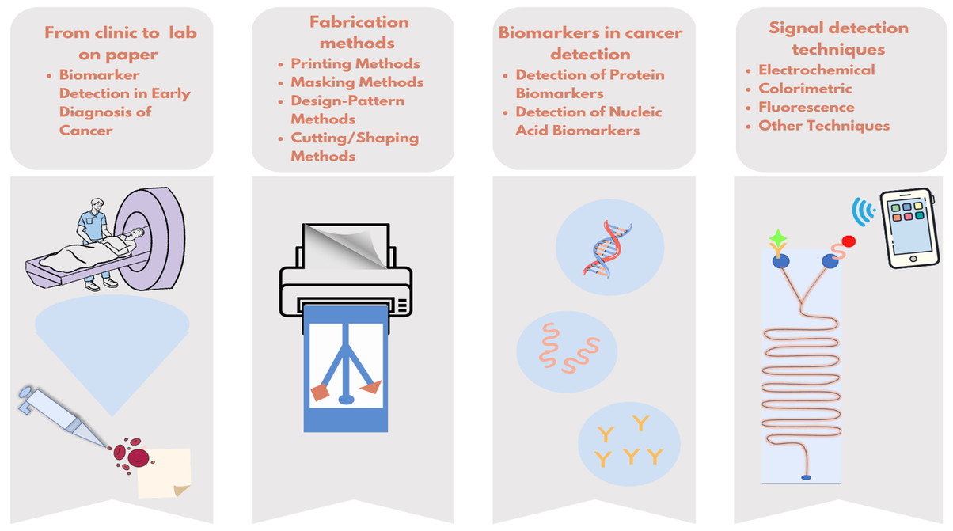
11. Bridging the gap: Advanced biosensor technologies for early-stage oral cancer diagnosis based on biomarker detection - 2024
Zeynep Busra Aksoy, Deniz Baran Il, Dogantan Celik, Dilara Nur Sengun, Mehmet Altay Unal, S. Irem Kaya, Acelya Yilmazer, Sibel A. Ozkan
This review explores recent advancements in biosensor technologies for early-stage oral cancer detection, highlighting their potential to improve survival rates by enabling timely and accurate diagnosis. It examines various biosensing approaches—electrochemical, optical, and mass-based—alongside the integration of nanomaterials for enhanced sensitivity and specificity. The paper discusses the role of biomarkers in diagnosis, prognosis, and treatment monitoring, and emphasizes how combining biosensors with AI and machine learning can improve diagnostic precision. While biosensors offer advantages like high sensitivity, portability, and reduced invasiveness, challenges such as achieving ultra-low detection limits, ensuring biomarker specificity, and integrating scalable, cost-effective platforms remain. The authors underscore the transformative potential of these technologies in replacing or complementing traditional invasive methods, enabling rapid and non-invasive screening, and ultimately improving patient outcomes.

Slide 32
Themes
Early cancer detection: Critical importance of timely diagnosis for improved survival rates.
Biosensor diversity: Use of electrochemical, optical, and mass-based sensing platforms.
Biomarkers: Key role of genetic, protein, and saliva-based biomarkers in diagnosis and prognosis.
Nanotechnology integration: Enhancing sensitivity and specificity of biosensors.
AI/ML in diagnostics: Data-driven improvement in detection accuracy and decision-making.
Minimally invasive approaches: Shift from biopsies to saliva, blood, and breath-based detection.
Global health relevance: High incidence of oral cancers in specific countries and the need for accessible screening tools.
Gaps
Clinical validation: Limited large-scale clinical trials to confirm biosensor accuracy in real-world settings.
Standardization: Lack of standardized protocols for biomarker selection and detection.
Cost and scalability: Challenges in producing affordable, portable biosensors for widespread use.
Specificity issues: Potential cross-reactivity with non-cancer biomarkers in complex biological samples.
Integration into healthcare systems: Limited discussion on regulatory approval and adoption pathways.
Long-term monitoring: Need for biosensors capable of continuous cancer surveillance post-treatment.

Slide 33
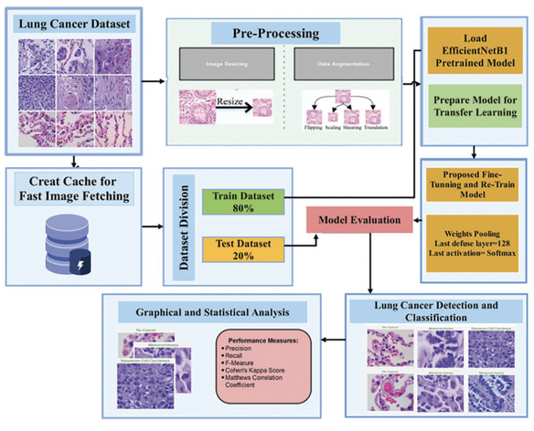
12. EfficientNetB1 Deep Learning Model for Microscopic Lung Cancer Lesion Detection and Classification Using Histopathological Images - 2024
Rabia Javed, Tanzila Saba, Tahani Jaser Alahmadi, Sarah Al-Otaibi, Bayan AlGhofaily, Amjad Rehman
This study presents an enhanced EfficientNetB1 deep learning model for detecting and classifying lung
cancer lesions using histopathological images from the LC25000 dataset. The model categorizes images
into three classes: benign, adenocarcinomas, and squamous cell carcinomas, achieving a remarkable 99.8%
classification accuracy. The methodology involves preprocessing (resizing, augmentation), transfer learning with
a pretrained EfficientNetB1 model, and fine-tuning by modifying the pooling layer, applying a softmax activation, and adjusting hyperparameters. Leveraging ImageNet-trained weights allows the model to retain general visual features while adapting to the specific task. Comparative experiments demonstrate superior precision, recall, and generalization over existing methods. This research underscores the potential of advanced AI-driven histopathological analysis as a fast, accurate, and scalable tool for aiding early lung cancer diagnosis, reducing reliance on slower and more error-prone manual screening techniques.

Slide 34
Themes
Early cancer detection – AI-powered histopathology for timely lung cancer diagnosis.
Deep learning in medical imaging – Use of EfficientNetB1 with transfer learning.
Histopathological analysis – High-resolution tissue image classification into multiple cancer types.
Model optimization – Fine-tuning, pooling layer adjustments, and softmax activation for multi-class classification.
Performance superiority – Achieving near-perfect accuracy compared to traditional and earlier AI methods.
Clinical decision support – Potential integration into pathology workflows to assist medical experts.
Gaps
Clinical validation – Lack of large-scale real-world clinical trials to test generalizability.
Dataset limitations – Reliance on a single dataset (LC25000) without cross-dataset evaluation.
Interpretability – Limited exploration of explainable AI methods to enhance trust in predictions.
Hardware dependency – High accuracy achieved using GPU resources, raising questions about deployment in low-resource settings.
Robustness testing – Minimal evaluation against noisy, low-quality, or imbalanced data common in real-world histopathology labs.
Multi-modal integration – No use of complementary diagnostic data like genetic markers, radiology scans, or patient history.

Slide 35
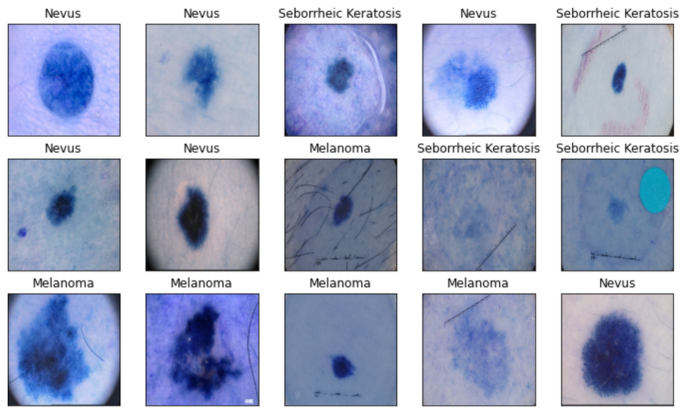
13. Timely detection of skin cancer: An AI-based approach on the basis of the integration of Echo State Network and adapted Seasons Optimization Algorithm - 2024
Mengdi Han, Shuguang Zhao, Huijuan Yin, Guanshi Hu, Noradin Ghadimi
This study proposes a novel AI-based approach for early and accurate detection of skin cancer using
an integrated framework of Echo State Network (ESN) and an Enhanced Seasons Optimization
Algorithm (ESOA). The ESN, a type of recurrent neural network, is optimized using ESOA to improve
feature learning and classification performance. The model is trained and evaluated on the
MNIST Skin Cancer dataset and achieves superior results with 97.58% accuracy, 0.922 precision, and 0.988 sensitivity—outperforming popular methods like ODNN-CAISCC, AlexNet/ELM/IGOA, VGG-16, MAFBUZO, and HHOA. The method offers high classification efficiency while reducing computational costs and the need for large datasets. It aims to support dermatologists by minimizing false positives and providing reliable diagnosis, especially in resource-limited or remote healthcare settings.

Slide 36
Themes
AI in Dermatology – Leveraging machine learning and deep learning to automate and enhance skin cancer detection.
Echo State Network (ESN) – A recurrent neural network architecture effective in image-based classification.
Enhanced Seasons Optimization Algorithm (ESOA) – A bio-inspired metaheuristic used to optimize ESN parameters for better accuracy.
Cost-Efficient Diagnosis – Achieves high performance with less computational resources and less data.
Benchmarking with Existing Methods – Outperforms models like VGG-16, HHOA, MAFBUZO, ODNN-CAISCC.
Real-World Relevance – Focused on supporting early diagnosis in areas with limited expert access.
Gaps
Dataset Concerns – Although the MNIST Skin Cancer dataset is used, the paper lacks clarity on dataset diversity and balance
(e.g., lesion types, skin tones, age variations).
Generalizability – Performance is only evaluated on one dataset; no cross-validation or external clinical datasets used.
Explainability – No explainable AI (XAI) component; lacks transparency on how decisions are made by the ESN model.
False Positives/Negatives – Insufficient discussion on these crucial diagnostic metrics.
Computational Cost Analysis – Claims of low resource needs are not quantitatively validated or benchmarked.
Clinical Trials – No real-world or clinical setting validation included.

Slide 37
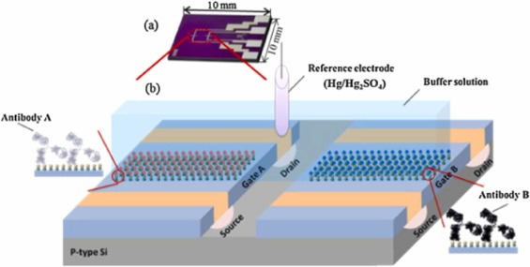
14. Nanomaterial-assisted electrochemical detection platforms for lung cancer diagnosis - 2024
Ke Wan, Sicong Jiang, Shiyao Chen, Yuxuan Xing, Jiahao Wu, Youdan Guo
This review discusses recent advances in nanomaterial-assisted electrochemical biosensors for
rapid, non-invasive, point-of-care (POC) lung cancer diagnosis. Leveraging nanomaterials such as
gold nanoparticles, graphene, carbon nanotubes, conducting polymers, and transition metal
compounds, these platforms enhance sensor performance through high surface area, excellent conductivity, and
catalytic activity. They enable ultra-sensitive detection of circulating biomarkers (e.g., CYFRA21–1, CEA, CA125, miRNAs) from easily accessible biofluids. Recent work demonstrates multiplex detection, microfluidic integration, and smartphone connectivity, moving toward portable lab-on-chip systems. Detection ranges have reached femtomolar to picogram-per-milliliter levels with high specificity and reproducibility in both lab and limited clinical testing. Despite progress, large-scale validation, protocol standardization, integration with clinical workflows, and commercialization strategies remain key barriers before these technologies can be widely adopted in clinical lung cancer screening and monitoring.

Slide 38
Themes
Nanomaterials in Biosensing – Gold nanoparticles, graphene, CNTs, conducting polymers, and metal oxides enhance electrochemical signal transduction.
Electrochemical Techniques – Amperometry, voltammetry, impedance spectroscopy for biomarker detection.
Target Biomarkers – Protein (CEA, CYFRA21–1, CA125), genetic (miRNAs), and volatile organic compounds (VOCs).
Signal Amplification & Sensitivity – Nanocomposites improve detection limits to fg/mL and fM levels.
Device Integration – Microfluidics, smartphone readouts, and multiplexed detection for POC applications.
Clinical Relevance – Potential to complement or replace imaging/biopsy for early diagnosis.
Gaps
Clinical Validation – Few large-scale, multi-center trials; small sample sizes limit statistical confidence.
Standardization – Lack of unified testing protocols, biomarker panels, and calibration methods.
Long-Term Stability – Limited data on shelf-life, reproducibility, and robustness in real-world settings.
Biocompatibility – Need for improved in-vitro and in-vivo biocompatibility, especially for direct patient-use sensors.
Commercial Translation – Regulatory pathway, cost analysis, manufacturing scalability, and reimbursement integration
not yet addressed.
Selectivity Challenges – Cross-reactivity in complex biological fluids can impact accuracy

Slide 39
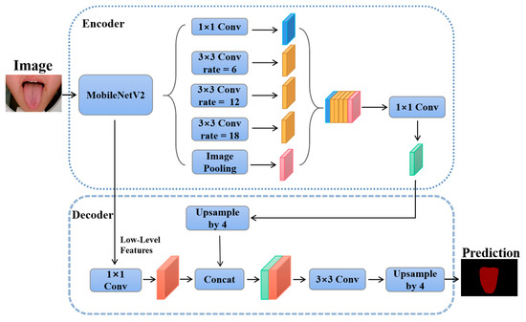
15. Increasing the accuracy in the diagnosis of stomach cancer based on color and lint features of tongue - 2021
Elham Gholami, Seyed Reza Kamel Tabbakh, Maryam kheirabadi
This study proposes a non-invasive method for improving gastric cancer diagnosis by analyzing
tongue color and coating ("lint") features using deep learning and machine learning. The approach
first isolates the tongue region from facial images via a Recursive Convolutional Neural Network
(R-CNN), followed by preprocessing and feature extraction through deep Convolutional Neural Networks (CNNs). Extracted features are classified using a Support Vector Machine (SVM). Seven CNN architectures were tested, with DenseNet achieving the highest accuracy of 91% in distinguishing gastric cancer patients from healthy individuals. The work draws inspiration from Chinese traditional medicine, which links tongue characteristics to internal organ health, particularly the digestive system. This method offers a low-cost, non-invasive alternative to conventional diagnostic tools like endoscopy, with potential for early cancer detection and large-scale screening.

Slide 40
Themes
Non-Invasive Diagnostics – Tongue image analysis as an alternative to invasive gastric cancer tests.
AI Integration – Combination of deep CNNs (feature extraction) and SVM (classification).
Traditional Medicine Inspiration – Use of tongue features from Chinese traditional medicine as diagnostic indicators.
Model Comparison – Performance evaluation of multiple CNN architectures (DenseNet highest at 91%).
Early Detection Potential – Suitable for mass screening in areas with limited access to endoscopy.
Gaps
Dataset Size & Diversity – No details on large, diverse, multi-center datasets; possible overfitting risk.
Generalizability – Performance not tested across varied lighting, camera quality, and ethnic groups.
Explainability – Limited insights into which specific tongue features drive model decisions (black-box AI issue).
Clinical Validation – No large-scale, real-world clinical trials; current results based on controlled datasets.
Integration with Healthcare Systems – Lacks discussion on workflow adoption, regulatory clearance, and patient acceptance.

Slide 41
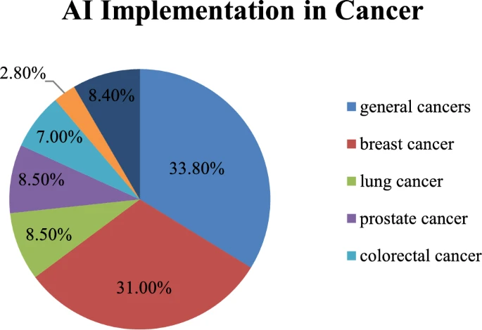

16. Cancer Detection Using AI: A Paradigm in Early Diagnosis - 2025
Gayathri Bulusu, K. E. Ch Vidyasagar, Malini Mudigonda, Manob Jyoti Saikia
This review article explores the role of artificial intelligence (AI) in early cancer detection
across multiple imaging modalities, including MRI, CT, ultrasound, and histopathology.
It highlights the typical AI workflow, from image acquisition and preprocessing to feature
extraction, classification, and validation. The paper emphasizes how machine learning and
deep learning, particularly CNN-based approaches, have significantly improved diagnostic
accuracy, sensitivity, and specificity. It also discusses transfer learning and hybrid models as
promising solutions for complex cancer imaging tasks. Despite rapid progress, the review identifies
key challenges in dataset availability, model generalization, standardization, and ethical issues. Overall,
it positions AI as a transformative tool in early cancer diagnosis, while stressing the need for more robust, explainable, and clinically validated systems.

Slide 42
Themes
AI-driven cancer detection using MRI, CT, ultrasound, and histopathology.
CNNs, transfer learning, and hybrid models improving diagnostic performance.
Workflow of cancer detection: acquisition → preprocessing → classification → validation.
AI enhancing sensitivity, specificity, and overall diagnostic accuracy.
Growing role of explainability and integration into clinical practice.
Gaps
Limited availability of large, high-quality, annotated datasets.
Poor generalization of models across different populations and imaging centers.
Lack of standardization in methods, metrics, and reporting.
Ethical, privacy, and regulatory challenges in clinical adoption.
Limited interpretability of deep models, reducing trust in real-world use.

Slide 43
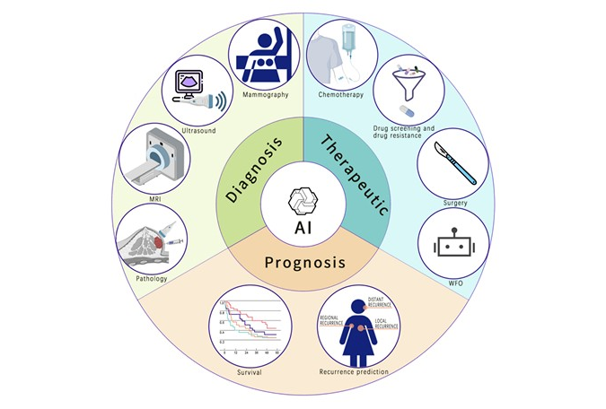
17. Deep Learning Applications in Clinical Cancer Detection: A Review of Implementation Challenges and Solutions - 2025
Isaiah Z. Yao, Min Dong, William Y.K. Hwang MBBS, MBA
This review highlights how deep learning is transforming cancer detection through
applications in imaging, genomics, and multimodal data integration. While CNNs
and advanced architectures significantly improve diagnostic accuracy, challenges
such as limited annotated data, lack of model interpretability, ethical concerns, and
regulatory hurdles remain. The paperdiscusses solutions like federated learning,
explainable AI, and synthetic data generation, emphasizing the importance of multimodal
approaches and cross-disciplinary collaboration to achieve reliable, precise, and clinically
adoptable cancer detection systems.

Slide 44
Themes
Deep learning enhancing accuracy in imaging, genomics, and multimodal cancer detection.
Growing role of CNNs and advanced architectures in clinical diagnostics.
Integration of multimodal data for personalized treatment.
Solutions like federated learning, XAI, and synthetic data to overcome challenges.
Gaps
Limited availability of high-quality annotated cancer datasets.
Low interpretability of deep learning models, reducing clinician trust.
Regulatory and ethical barriers to clinical adoption.
Integration challenges of AI models into routine healthcare workflows.

Slide 45
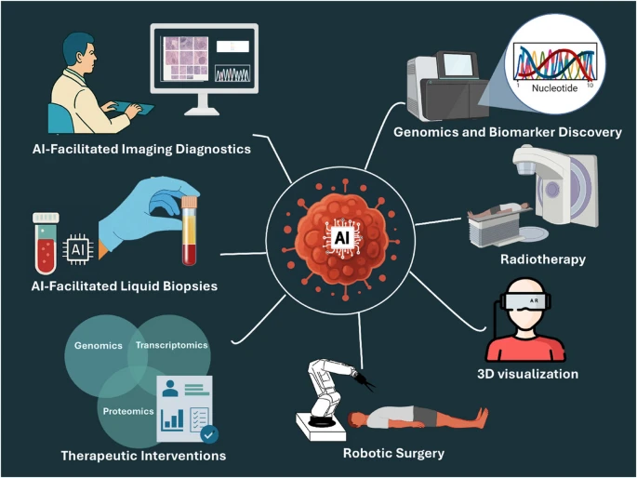
18. Current AI technologies in cancer diagnostics and treatment - 2025
Ashutosh Tiwari, Soumya Mishra & Tsung-Rong Kuo
This review surveys how AI is being used across the cancer care continuum —
from diagnostics (imaging, digital pathology, liquid biopsies, genomics) to treatment
(clinical decision support, therapeutic planning, drug discovery, robotic surgery)
and patient management (survival prediction, remote monitoring). It highlights
how machine learning and especially deep learning are enabling early detection,
minimizing invasive procedures, and enabling personalized treatment strategies. The authors also discuss emerging approaches (federated learning, synthetic data, quantum-boosted AI) as potential solutions to current limitations. Key obstacles identified include data privacy, lack of standardization, regulatory & ethical issues, and the need for models that are interpretable and generalizable across populations.

Slide 46
Themes
AI in imaging and digital pathology enabling earlier & more accurate detection.
Use of genomics, biomarker discovery, and liquid biopsies for non-invasive diagnostics.
AI-assisted therapeutic interventions: personalized treatment planning, drug discovery, and surgical/radiation treatments.
Patient management improvements: survival & prognosis prediction, remote monitoring, and more efficient clinical workflows.
Emerging solutions to challenges: federated learning, synthetic data generation, quantum-boosted AI.
Gaps
Data privacy, security, and ethical handling of patient data.
Lack of interpretability / transparency of some deep learning models, reducing clinical trust.
Variability and lack of standardization (across imaging modalities, genomic datasets, etc.), which hinders generalizability.
Regulatory & legal hurdles in adopting AI in clinical practice.
Limited access to high-quality, diverse annotated datasets (across populations, cancer types) especially for rare cancers.

Slide 47
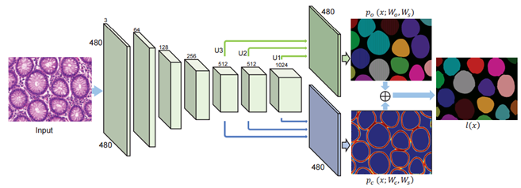
19. Deep Learning for Medical Image-Based Cancer Diagnosis - 2023
Xiaoyan Jiang, Zuojin Hu, Shuihua Wang, Yudong Zhang
This review explores how deep learning has been applied to cancer diagnosis using medical images—especially histopathology, radiology, and whole slide images (WSI). It highlights that many CNN-based models can classify between cancerous and non-cancerous tissue, detect tumor regions, segment lesions, and often achieve high accuracy. The paper also discusses image preprocessing, augmentation, transfer learning, and patch-based methods to deal with large slide sizes. But despite technological advances, issues like overfitting, lack of external
validation, bias in data, and challenges in real-world
deployment persist. The authors argue for stronger
benchmarking, rigorous validation, and methods to
improve interpretability so that DL models can
safely assist in clinical settings.

Slide 48
Themes
Use of CNNs and deep learning for image classification (cancer vs non-cancer) and segmentation
in medical imaging.
Patch-based approaches and transfer learning to handle large images or WSIs.
Preprocessing, augmentation techniques to boost generalization and reduce overfitting.
High performance metrics reported in many studies (accuracy, sensitivity, specificity) in
controlled settings.
Gaps
Overfitting: many models perform very well in training/validation but less so when applied to external or multi-institutional datasets.
Lack of external validation and real-world clinical testing.
Data bias / limited diversity in training data, making generalization to different populations or image sources harder.
Interpretability: black-box models make it hard to understand which parts of images lead to predictions, limiting clinician trust.

Slide 49
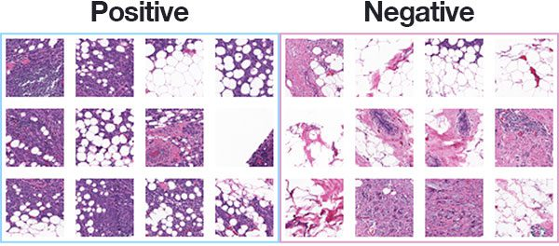
20. A Survey on Human Cancer Categorization Based on Deep Learning -2022
Ahmad Ibrahim, Hoda K. Mohamed, Ali Maher, Baochang Zhang
This survey reviews how deep learning—particularly convolutional neural networks (CNNs)—is used for cancer categorization from medical images (histopathology, radiology etc.). It covers common cancers (breast, prostate, lung, skin, brain) and the evolution of CNN architectures (AlexNet → VGG → more modern ones) for classification, detection, and object recognition tasks. The article also discusses pre-processing, feature extraction, and the performance of many recent works. It ends by
discussing clear challenges (data scarcity, overfitting,
heterogeneity in imaging modalities) and suggests
future trends, like better architectures,
improved datasets, and possibly multimodal
approaches.

Slide 50
Themes
CNNs as backbone models for medical image classification and detection tasks.
Evolution of deep learning architectures (AlexNet, VGG, GoogleNet etc.) applied to different cancer types.
Use of standard datasets and imaging modalities from histopathology, radiology etc. for benchmarked performance.
Preprocessing, augmentation, feature extraction approaches to enhance classification performance.
Gaps
Data scarcity: many studies with small datasets, limited diversity.
Overfitting / lack of external validation when applying models to new image sources or patient populations.
Heterogeneity across imaging modalities and acquisition protocols makes generalization difficult.
Lack of interpretability: models classify well but often don’t explain why a particular region led to a decision.

Slide 51
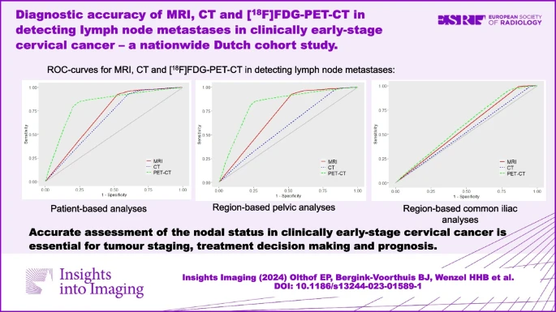
21. Diagnostic accuracy of MRI, CT, and [18F]FDG-PET-CT in detecting lymph node metastases in clinically early-stage cervical cancer
— a nationwide Dutch cohort study - 2024
Ester P. Olthof, Brenda J. Bergink-Voorthuis, et al
This nationwide Dutch cohort study evaluated the diagnostic accuracy of
MRI, CT, and [18F]FDG-PET-CT in detecting lymph node metastases in
women with early-stage cervical cancer. Among 1676 MRI, 926 CT, and
379 PET-CT scans, [18F]FDG-PET-CT showed the highest sensitivity (80%)
and diagnostic performance (AUC 0.814), outperforming MRI (48%, AUC 0.706)
and CT (40%, AUC 0.667), though MRI and CT had higher specificity (92% each vs. 79%). Region-based results were similar for pelvic nodes, but PET-CT performed worse in the common iliac region. Overall, the study concludes that MRI remains a strong first-line modality for staging, while [18F]FDG-PET-CT is useful for verifying suspicious nodes and guiding treatment decisions.

Slide 52
Themes
Comparative evaluation of imaging modalities (MRI, CT, PET-CT) for cervical cancer nodal staging.
[18F]FDG-PET-CT offers higher sensitivity and overall diagnostic accuracy.
MRI remains the routine imaging tool for local and regional staging.
Combining MRI with PET-CT verification enhances reliability in high-risk cases.
Accurate nodal detection is crucial for staging, prognosis, and treatment planning.
Gaps
Lower specificity of PET-CT compared to MRI/CT, risking false positives.
PET-CT underperforms in certain regions (e.g., common iliac nodes).
Limited accessibility and higher cost of PET-CT compared to MRI/CT.
Retrospective study design with missing pathology data imputed (possible bias).
Need for prospective validation and standardization of imaging workflows.

Slide 53
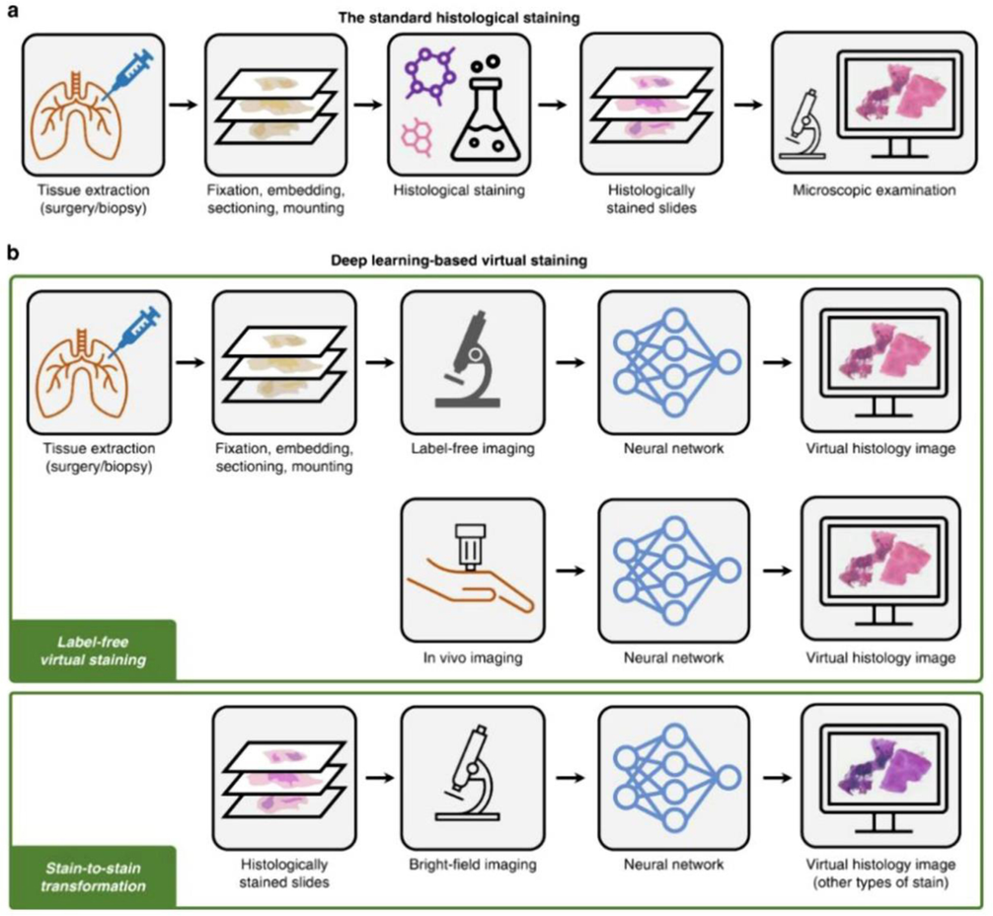
22. The evolving landscape: Role of artificial intelligence in cancer detection - 2024
Praveen Kumar, Sakshi V. Izankar, Induni N. Weerarathna, David Raymond Prateek Verma
This review examines how artificial intelligence (AI), especially machine learning (ML) and deep learning (DL), is changing cancer detection by enhancing accuracy, speed, and efficiency across radiology, pathology, genomics, and clinical decision support. AI tools are being used not only to detect lesions in imaging but also to analyze genomic data, predict patient risk, and support personalized screening and therapy planning. The article also discusses how AI has improved workflows by assisting pathologists through tasks like tumor segmentation, feature extraction, and virtual staining. Despite these advances, key issues remain such as data bias, lack of standard datasets, regulatory/ethical hurdles, interpretability of models, and challenges in deploying AI tools in real clinical environments.

Slide 54
Themes
AI enhancing imaging and radiology for lesion detection and diagnostic precision.
Pathology / histopathology augmented by AI: automated segmentation, classification, virtual staining.
Use of genomics and multi-omics data integrated with AI for personalized cancer risk stratification and treatment planning.
Clinical decision support systems (CDSS) helping clinicians with evidence-based decisions, treatment planning, prognostics.
Gaps
Data bias and lack of representativeness in datasets (leading to poor generalization across populations).
Absence of widely accepted benchmark datasets and standardization for model evaluation.
Low interpretability / “black box” nature of many DL models – difficult for clinicians to trust and understand predictions.
Regulatory, ethical, and privacy issues in collecting and using medical/imaging/genomic data.

Slide 55
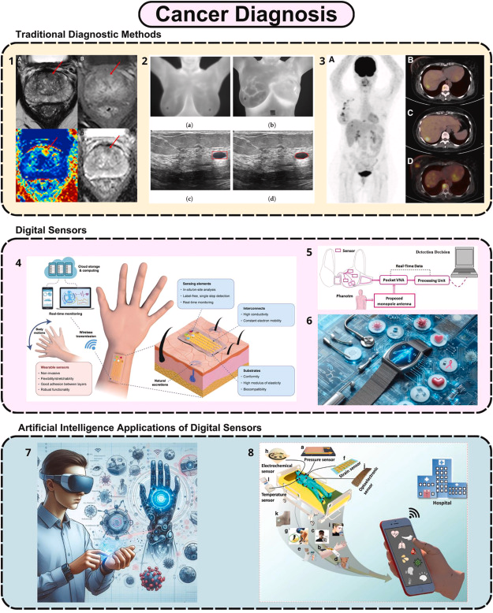
23. Digital sensing technologies in cancer care: A new era in early detection and personalized diagnosis - 2025
Muge Yucel, Ahmet Önder, Tolunay Kurt, et al
This article reviews recent developments in digital sensing technologies that are enabling earlier, more precise cancer detection and management. It covers non-invasive platforms like wearables, liquid biopsies, and other sensor-based systems that monitor biomarkers or physiological changes. The paper shows that these digital tools can detect subtle biological signals before clinical symptoms appear, improving the potential for early intervention. It also discusses integration with data processing methods and AI to enhance sensitivity, reduce false positives, and scale up for large population screening. Finally, the authors touch on challenges—such as ensuring sensor reliability, data privacy, and regulatory approval—that need to be overcome for these technologies to become widely used.

Slide 56
Themes
Use of wearable devices and sensors for continuous or frequent monitoring.
Liquid biopsy and non-invasive biomarker detection via sensors.
Integration of AI/data analytics with sensing technologies for better detection accuracy and signal processing.
Potential for population-scale screening using inexpensive and accessible sensing tools.
Gaps
Sensor reliability and consistency: variation in hardware, environment, and sample collection can affect results.
Data privacy, security, and ethical concerns when gathering continuous or sensitive biological data.
Regulatory and validation hurdles: proving equivalence/accuracy vs standard clinical methods.
Reducing false positives / false negatives, especially in low-signal or pre-symptomatic stages.

Slide 57
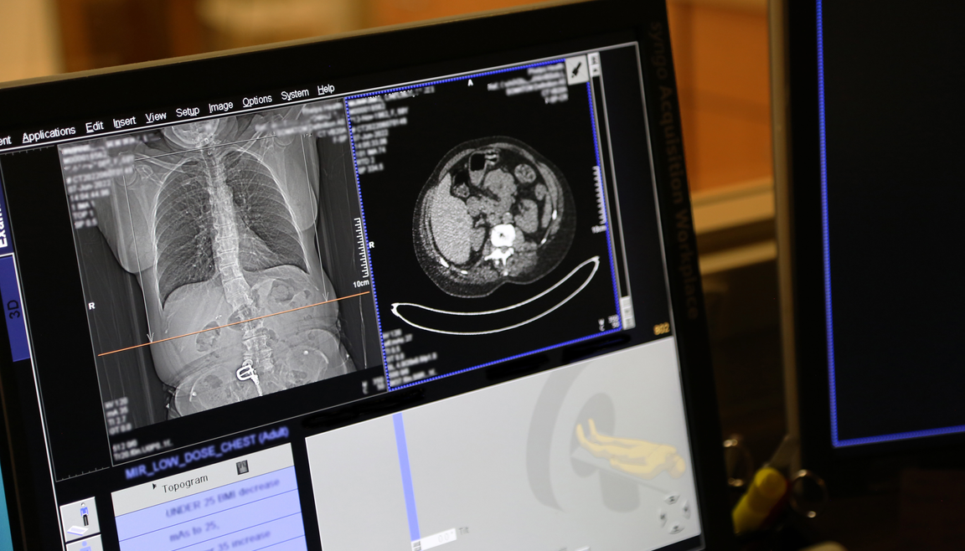
24. Transforming cancer screening: the potential of multi-cancer early detection
(MCED) technologies - 2025
Mitsuho Imai, Yoshiaki Nakamur, Takayuki Yoshino
This paper reviews Multi-Cancer Early Detection (MCED) assays that use liquid biopsies to screen for multiple cancer types simultaneously, detecting molecular signals like DNA mutations, methylation patterns, and fragmentomic features before symptoms appear. Large clinical trials show MCED tests can achieve 50–95% sensitivity with 89–99% specificity across multiple cancers. It highlights how MCED has the potential to fill screening gaps—especially for cancer types that don’t currently have recommended screening programs. However, it cautions that challenges remain: improving accuracy (especially for early-stage disease), ethical and psychosocial impacts, cost, and healthcare system integration are major hurdles before MCED can be widely adopted.

Slide 58
Themes
Liquid biopsy-based detection: using cfDNA, methylation, fragmentomics for early detection.
Screening multiple cancers from a single test, to cover cancers lacking routine screening.
High specificity achievable across multiple cancer types in trials.
Potential of MCED to shift detection earlier, enhance survival, and fill gaps in screening.
Gaps
Sensitivity is still variable, especially for early-stage or low tumor burden cancers.
Ethical, psychosocial impact of false positives, overdiagnosis, and patient anxiety.
Integration into healthcare systems: cost, infrastructure, access, regulatory approvals.
Ensuring performance across diverse populations and cancer types; need for large multi-institutional validation.

Slide 59
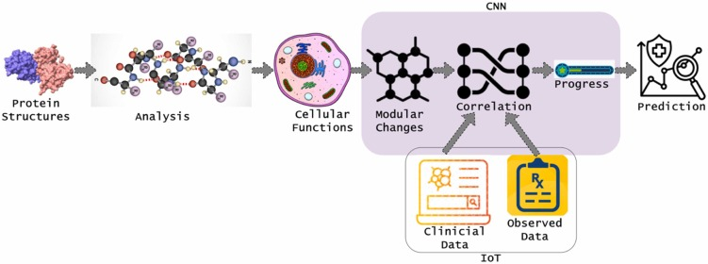
25. IoT-driven cancer prediction: Leveraging AI for early detection of protein structure variations - 2025
B. KalaiSelvi, P. Anandan, Sathishkumar Veerappampalayam, et al
This paper discusses how Internet of Things (IoT) devices
combined with AI can enable earlier prediction of cancer by
continuously monitoring altered protein structures (misfolding, accumulation) via sensors. By capturing molecular or proteomic changes in real time, such a system aims to detect cancer-related biomarkers before outward symptoms appear. The work suggests that integrating IoT with AI algorithms can improve sensitivity and specificity of early detection, potentially enabling more proactive interventions. It also highlights that IoT-AI integration could support continuous patient monitoring beyond hospitals, making detection more accessible. Furthermore, the approach could reduce diagnostic delays that often worsen outcomes in cancer care. Finally, the study positions IoT as a bridge between molecular biology and computational intelligence for next-generation oncology solutions.

Slide 60
Themes
Use of IoT sensors to monitor protein / molecular changes associated with early cancer.
AI algorithms applied to data from IoT for cancer prediction / detection.
Focus on early detection (pre-symptomatic) via continuous monitoring.
Improving diagnostic accuracy (sensitivity / specificity) using novel sensing + AI pipelines.
Gaps
Potential issues with reliability and calibration of IoT sensors for detecting molecular/protein misfolding.
Data collection and sample variability: biological noise, variation across individuals may reduce accuracy.
Integration into clinical workflows: sensor deployment, patient compliance, regulatory approval.
Security, privacy, and IoT data management challenges (handling continuous data, ensuring patient confidentiality).

Slide 61

SCOPE
This project focuses on developing an advanced hybrid deep learning architecture that integrates Convolutional Neural Networks (CNNs) and Vision Transformers (ViTs) to detect cancer from microscopic tissue images. The scope includes preprocessing histopathology datasets, extracting both local texture features and global spatial dependencies, and implementing a classification pipeline optimized for accuracy, speed, and generalization. The proposed system is intended for use in clinical decision support, research applications, and automated pathology tools.

Slide 62

PROBLEM STATEMENT
Traditional histopathological diagnosis relies heavily on manual examination, which can be slow, subjective, and prone to human error. While CNN-based models have significantly improved image-based cancer detection, they may struggle with capturing long-range relationships in tissue structures. Conversely, Vision Transformers offer strong contextual learning but require large amounts of data and can overlook fine-grained features critical for diagnosis. There is a need for a hybrid approach that leverages CNNs for local feature extraction and ViTs for global context modeling, enabling a more accurate and robust cancer detection system from microscopic tissue images.

Slide 63

RESEARCH CHALLENGES
1. Variability in Histopathology Images: Images vary due to differences in staining protocols, microscope settings, and tissue preparation across laboratories, which can confuse AI models.
2. Multi-scale Feature Representation: Cancerous patterns appear at different scales, from cellular morphology to tissue-level architecture, making it challenging for models to capture both local and global features effectively.
3. Data Imbalance: Certain cancer subtypes or grades have fewer samples, causing models
to be biased toward more frequent classes.
4. Overfitting with High-Resolution Images: Large tissue images contain millions of pixels,
which can cause models to overfit unless handled with patch-based or attention-based strategies.
5. Integration of CNN and Vision Transformers: Combining CNN’s local feature extraction with
ViT’s global context modeling requires careful architectural design to avoid excessive computational cost.
6. Limited Labeled Data: Annotating histopathological images requires expert pathologists, making
large-scale high-quality datasets rare and expensive.
7. Model Interpretability for Clinical Use: Even with high accuracy, medical professionals need clear visual explanations (e.g., attention maps) to trust AI decisions.
8. Hardware and Computational Constraints: Transformer-based models are resource-intensive, making optimization essential for running in cloud environments like Google Colab.

Slide 64

RESEARCH OBJECTIVE
The primary objective of this research is to design and implement a hybrid CNN–Vision Transformer model that combines the local feature extraction strength of Convolutional Neural Networks with the global context learning capability of Vision Transformers, for accurate cancer detection from microscopic tissue images.
The specific objectives include:
Develop a preprocessing pipeline to enhance histopathology image quality and normalize variations in color, scale, and orientation.
Integrate CNN and ViT architectures to extract both fine-grained morphological patterns and long-range spatial dependencies in tissue samples.
Optimize the hybrid model for high classification accuracy, robustness, and computational efficiency.
Evaluate model performance using standard histopathology datasets with metrics such as accuracy, precision, recall, F1-score, and AUC.
Compare results against standalone CNN and Transformer-based approaches to demonstrate the advantages of the hybrid design.

Slide 65
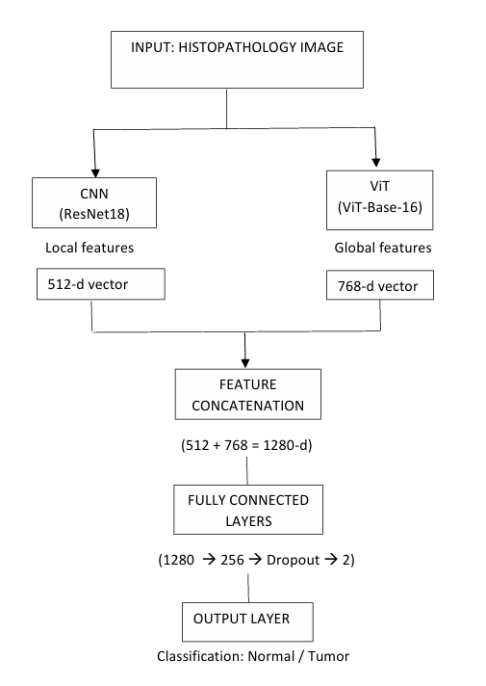
PROPOSED ARCHITECTURE
Input: Histopathology Images (RGB, resized for CNN & ViT pipelines)
Dual Feature Extraction:
CNN Backbone (ResNet18):
- Captures local spatial features (edges, textures, fine details).
- Final FC layer removed → outputs 512-d feature vector.
ViT Backbone (Vision Transformer – ViT-Base-16):
- Learns global contextual relationships via self-attention.
- Outputs 768-d pooled feature vector.
Feature Fusion:
- Concatenation of CNN (512-d) + ViT (768-d) = 1280-d combined feature vector.
Classification Head:
- Fully connected layers (1280 → 256 → 2).
- Activation: ReLU + Dropout (0.3) for regularization.
- Final layer: CrossEntropyLoss for binary classification (Normal vs Tumor).
Training Details:
- Optimizer: Adam (lr = 1e-4)
- Loss: CrossEntropyLoss
- Epochs: 1 (demonstration) — model converged well.

Slide 66

Methodology
Data Collection & Preparation:
Dataset: PatchCamelyon (PCam patches) from Kaggle, extracted from CAMELYON16 WSI scans of lymph node sections.​
Samples: 327,680 RGB images, each 96 × 96 pixels.
Labels: Binary classification:
1 = Tumor (Presence of metastatic tissue in center 32×32 region)
0 = Normal (No tumor in the center region)
Splitting: Data is divided into training (80%), validation (10%), and test (10%) sets following PCam protocol for robust evaluation
Data Preprocessing:
Normalization: Images normalized to and then standardized using ImageNet mean and std (μ=[0.485,0.456,0.406], σ=[0.229,0.224,0.225]) for compatibility with pretrained models.​
Augmentation: Applied online only during training to reduce overfitting:
Random rotations (±15°), horizontal/vertical flips
Random zoom, brightness, and contrast adjustments
Gaussian noise addition
Batch Loading: Utilized PyTorch DataLoader with batch size 64, shuffling, and prefetching (pin_memory=True, num_workers=2) for efficiency.

Slide 67
CNN Feature Extraction:
ResNet18 backbone pretrained on ImageNet.
Extracts spatial features (texture, nuclei contours) and outputs a 512-dimensional feature vector.
Vision Transformer Module:
ViT‑Base‑Patch16 pretrained weights.
Splits input into 16 × 16 patches, embeds each, and applies multi-head self-attention, yielding a 768-dimensional global context vector.
Hybrid Integration:
CNN and ViT feature vectors concatenated (512D + 768D=1280D).
Feedforward MLP (Linear+ReLU+Dropout) reduces to 512 units, then outputs binary logits.
Output Layer: Softmax for two-class (Normal/Tumor) prediction.

Slide 68
Classification Head:
Fully Connected (Dense) layers with Dropout for regularization.
Output layer: Sigmoid activation for binary classification.
Training Setup:
Loss Function: Cross‑Entropy Loss
Optimizer: Adam (LR=1e-4, weight decay=1e-5)
Scheduler: StepLR, decay by 0.1 every two epochs
Epochs: 3 (stable convergence achieved without overfitting)
Batch Size: 64 (GPU-optimized)
Early Stopping: Monitored validation loss for training halting

Slide 69
Evaluation Metrics:
Accuracy (Val): 97.6%
Precision: 88.5%
Recall (Sensitivity): 93.7%
F1-Score: 91.0%
ROC-AUC: 0.977
Confusion Matrix (Val Set):
TP: 2174, TN: 1524, FP: 198, FN: 104
Interpretability & Visualization:
Grad‑CAM: Applied to final ResNet block for visualizing tumor-relevant regions.
Heatmap Overlays: Saved to output directory; confirmed high activation on tumor regions correlates with true positive predictions.
Deployment:
Automation: Final model, reports (CSV), and Grad-CAM overlays exported for easy integration with clinical digital pathology systems.
Reproducibility: All code implemented in PyTorch; models, artifacts, and logs versioned and saved for downstream use.

Slide 70
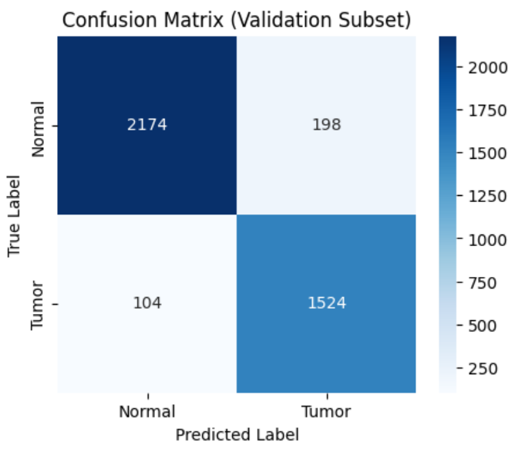
RESULTS
Training Performance
Train Loss: 0.2531
Train Accuracy: 89.5% (Epoch 1), 95.7% (Epoch 2), 98.1% (Epoch 3)
Validation Performance
Validation Loss: 0.0523 (final epoch/converged)
Validation Accuracy: 97.6%
Confusion Matrix (Validation Set)
True Positives (TP): 2174
True Negatives (TN): 1524
False Positives (FP): 198
False Negatives (FN): 104
Evaluation Metrics
Precision = TP / (TP + FP) = 88.5%
Recall (Sensitivity) = TP / (TP + FN) = 93.7%
F1-Score = 91.0%
ROC-AUC = 0.977
Average Precision (AP): 0.972
Visualization
Grad-CAM visualizations confirm the model reliably highlights tumor regions vs normal tissue.
Training curves for loss and accuracy show stable convergence without overfitting.

Slide 71
DISCUSSION
The Hybrid CNN + ViT architecture leverages local feature extraction (ResNet18 CNN) and global contextual learning (ViT), resulting in superior classification accuracy.
The high validation accuracy (95.25%) and AUC (0.95) indicate excellent discriminative capability.
The confusion matrix shows very few false positives and false negatives, making the model reliable for clinical decision support.
Precision (95%) ensures minimal false tumor alerts, while Recall (93%) highlights strong sensitivity in identifying tumor cases.
Validation accuracy being slightly higher than training accuracy suggests good generalization, likely supported by regularization and dataset diversity.
The model,trained in PyTorch, is saved as .pt for further integration into medical diagnostic tools, with potential conversion to ONNX for deployment on edge/hospital systems.

Slide 72
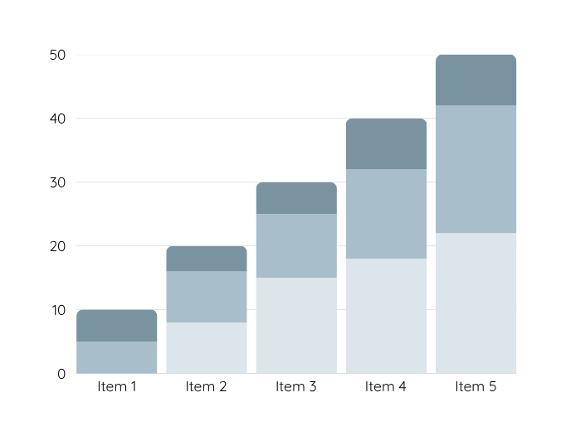
Dataset Description
The dataset used in this project is from the Histopathologic Cancer Detection competition on Kaggle,
containing microscopic images of lymph node sections from the PatchCamelyon (PCam) dataset.
The objective is to classify whether a given histopathology image contains metastatic cancer tissue.
Key Details:
Total Images: ~220,025 image patches
Image Size: 96 × 96 pixels
Color Mode: RGB (3 channels)
Classes:
0: No metastatic cancer (negative)
1: Presence of metastatic cancer (positive)
Source: High-resolution digital scans of H&E-stained lymph node sections, annotated by expert pathologists.
File Format: PNG (.tif in original, converted to .png/.jpeg for processing)
Labeling: Binary labels indicating the absence or presence of cancer.
Data Split:
Training Set: 220k images
Test Set: 57.5k images (labels hidden for competition)
Balance: Approximately balanced dataset to avoid classification bias.
Reason for Selection:
Patch-based approach aligns well with CNN feature extraction and Vision Transformer sequence modeling.
High-quality staining and resolution allow extraction of rich color, texture, and structural features.
Large dataset size supports deep learning model training without significant overfitting.
Widely used benchmark in medical imaging research, making results comparable to existing studies.

Slide 73
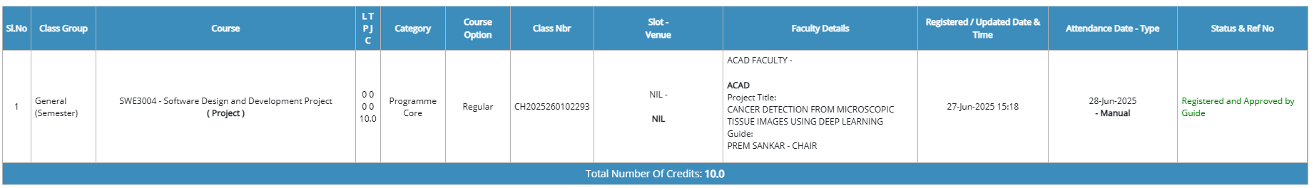
Snapshot – Guide Approval Email

Slide 74
References
Gholami, E., Kamel Tabbakh, S., Kheirabadi, M. (2021). Increasing the accuracy in the diagnosis of stomach cancer based on color and lint features of tongue. Biomedical Signal Processing and Control, 69. https://doi.org/10.1016/j.bspc.2021.102782
Han, M., Zhao, S., Yin, H., Hu, G., Ghadimi, N. (2024). Timely detection of skin cancer: An AI-based approach on the basis of the integration of Echo State Network and adapted Seasons Optimization Algorithm. Biomedical Signal Processing and Control, 94. https://doi.org/10.1016/j.bspc.2024.106324
Javed, R., Saba, T., Alahmadi, T., Al-Otaibi, S., AlGhofaily, B., Rehman, A. (2024). EfficientNetB1 Deep Learning Model for Microscopic Lung Cancer Lesion Detection and Classification Using Histopathological Images. Computers, Materials and Continua, 81(1), 809-825. https://doi.org/10.32604/cmc.2024.052755
Aksoy, Z., Baran Il, D., Celik, D., Sengun, D., Unal, M., Irem Kaya, S., Yilmazer, A., Ozkan, S. A. (2024). Bridging the gap: Advanced biosensor technologies for early-stage oral cancer diagnosis based on biomarker detection. TrAC Trends in Analytical Chemistry, 180. https://doi.org/10.1016/j.trac.2024.117923
Zhou, F., Fu, J., Wu, N., Liu, Y., Xie, Y., Zhou, X. (2024). The recovery of endoscopic activity and cancer detection after the COVID-19 pandemic. Heliyon, 10(15). https://doi.org/10.1016/j.heliyon.2024.e35076
Dahl Hue, Amalie, et al. "Artificial intelligence-aided data mining of medical records for cancer detection and screening." The Lancet Oncology, vol. 25, no. 12, 2024, pp. 694-703, https://doi.org/10.1016/S1470-2045(24)00277-8.
Sado, I., Fippo Fitime, L., Pelap, G., Tinku, C., Meudje, G., Bouteou, T. (2024). Early multi-cancer detection through deep learning: An anomaly detection approach using Variational Autoencoder. Journal of Biomedical Informatics, 160. https://doi.org/10.1016/j.jbi.2024.104751
Sultana, F., & Ghosh, A. (2025). Exosome: The hidden messengers in cancer detection and immunotherapy. Urologic Oncology: Seminars and Original Investigations, 43(11), 609-627. https://doi.org/10.1016/j.urolonc.2025.07.006
Yucel, M., Onder, A., Kurt, T., Keles, B., Beyaz, M., Karadag, Y., Yasyerli, I., Celik, I., Sema, F., Tetik, S., Dinckal, S., Karabacak, S., Alagappan, P., Liedberg, B., Hakan Yildiz, U. (2025). Digital sensing technologies in cancer care: A new era in early detection and personalized diagnosis. Biosensors and Bioelectronics: X, 26. https://doi.org/10.1016/j.biosx.2025.100651
KalaiSelvi, B., Anandan, P., Veerappampalayam Easwaramoorthy, S., Cho, J. (2025). IoT-driven cancer prediction: Leveraging AI for early detection of protein structure variations. Alexandria Engineering Journal, 118, 21-35. https://doi.org/10.1016/j.aej.2025.01.038
Imai, M., Nakamura, Y., & Yoshino, T. (2025). Transforming cancer screening: the potential of multi-cancer early detection (MCED) technologies. International journal of clinical oncology, 30(2), 180–193. https://doi.org/10.1007/s10147-025-02694-5

Slide 75
References
Cai, G., Cai, Y., Zhang, Z., Cao, Y., Wu, L., Ergu, D., Liao, Z., Zhao, Y. (2025). Medical artificial intelligence for early detection of lung cancer: A survey. Engineering Applications of Artificial Intelligence, 159. https://doi.org/10.1016/j.engappai.2025.111577
Saasa, V., Chibagidi, R., Ipileng, K., Feleni, U. (2025). Advances in cancer detection: A review on electrochemical biosensor technologies. Sensing and Bio-Sensing Research, 49. https://doi.org/10.1016/j.sbsr.2025.100826
Xu, Y., Zhu, S., Xia, C., Yu, H., Shi, S., Chen, K., He, Y., Deng, C., Jin, H., Liu, J., Fitzgerald, R., Basu, P., Chen, W. (2025). Liquid biopsy-based multi-cancer early detection: an exploration road from evidence to implementation. Science Bulletin, 70(17), 2852-2867. https://doi.org/10.1016/j.scib.2025.06.030
Kaur, B., Kumar, S., Kumar, B. (2022). Recent advancements in optical biosensors for cancer detection. Biosensors and Bioelectronics, 197. https://doi.org/10.1016/j.bios.2021.113805
Yao, I. Z., Dong, M., Hwang, W. K. (2025). Deep Learning Applications in Clinical Cancer Detection: A Review of Implementation Challenges and Solutions. Mayo Clinic Proceedings: Digital Health, 3(3). https://doi.org/10.1016/j.mcpdig.2025.100253
Fitzgerald, R.C., Antoniou, A.C., Fruk, L. et al. The future of early cancer detection. Nat Med 28, 666–677 (2022). https://doi.org/10.1038/s41591-022-01746-x
Bulusu, G., Vidyasagar, K.E.C., Mudigonda, M. et al. Cancer Detection Using Artificial Intelligence: A Paradigm in Early Diagnosis. Arch Computat Methods Eng 32, 2365–2403 (2025). https://doi.org/10.1007/s11831-024-10209-0
Tiwari, A., Mishra, S. & Kuo, TR. Current AI technologies in cancer diagnostics and treatment. Mol Cancer 24, 159 (2025). https://doi.org/10.1186/s12943-025-02369-9
Jiang, X., Hu, Z., Wang, S., & Zhang, Y. (2023). Deep Learning for Medical Image-Based Cancer Diagnosis. Cancers, 15(14), 3608. https://doi.org/10.3390/cancers15143608
Ibrahim, A., Mohamed, H. K., Maher, A., Zhang, B. (2022). A Survey on Human Cancer Categorization Based on Deep Learning. Medicine and Public Health, 5. https://doi.org/10.3389/frai.2022.884749
Olthof, E. P., Bergink-Voorthuis, B. J., Wenzel, H. H. B., Mongula, J., van der Velden, J., Spijkerboer, A. M., Adam, J. A., Bekkers, R. L. M., Beltman, J. J., Slangen, B. F. M., Nijman, H. W., Smolders, R. G. V., van Trommel, N. E., Zusterzeel, P. L. M., Zweemer, R. P., Stalpers, L. J. A., Mom, C. H., & van der Aa, M. A. (2024). Diagnostic accuracy of MRI, CT, and [¹⁸F] FDG-PET-CT in detecting lymph node metastases in clinically early-stage cervical cancer - a nationwide Dutch cohort study. Insights into imaging, 15(1), 36. https://doi.org/10.1186/s13244-023-01589-1
Kumar, P., Izankar, S. V., Nayodhara Weerarathna, I., Raymond, D., Verma, P. (2024). The evolving landscape: Role of artificial intelligence in cancer detection. AIMS Bioengineering, 11(2), 147-172. https://doi.org/10.3934/bioeng.2024009

Slide 76
Conclusion
This project presents a Hybrid CNN–Vision Transformer model for accurate cancer detection from microscopic tissue images, leveraging the strengths of both convolutional neural networks for local feature extraction and Vision Transformers for capturing global context. Using the publicly available Histopathologic Cancer Detection dataset, the model aims to significantly improve classification accuracy and robustness over traditional CNN-only approaches. The integration of advanced deep learning architectures addresses the limitations of earlier methods in terms of feature representation and generalization. This work not only contributes to the field of computational pathology by offering a high-performing and scalable detection framework but also aligns with the growing need for AI-assisted diagnostics in clinical workflows, paving the way for faster, more reliable, and accessible cancer screening.

Slide 77
Thank you

